Slide 1



Group 2 Classwork_20.10.2025
View in Power BI
Last data refresh:
10/20/2025 9:15:08 PM UTC
Downloaded at:
10/20/2025 10:07:58 PM UTC

Slide 2
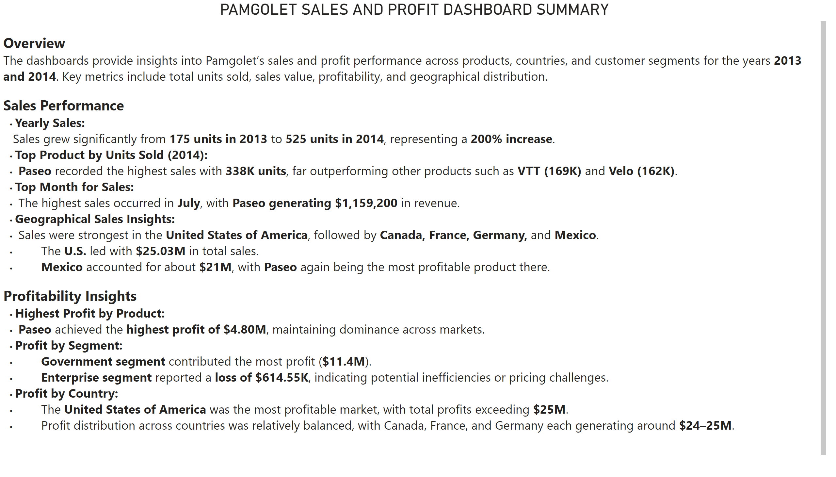
Summary
Notes:
PAMGOLET SALES AND PROFIT DASHBOARD SUMMARY
No alt text provided

Slide 3
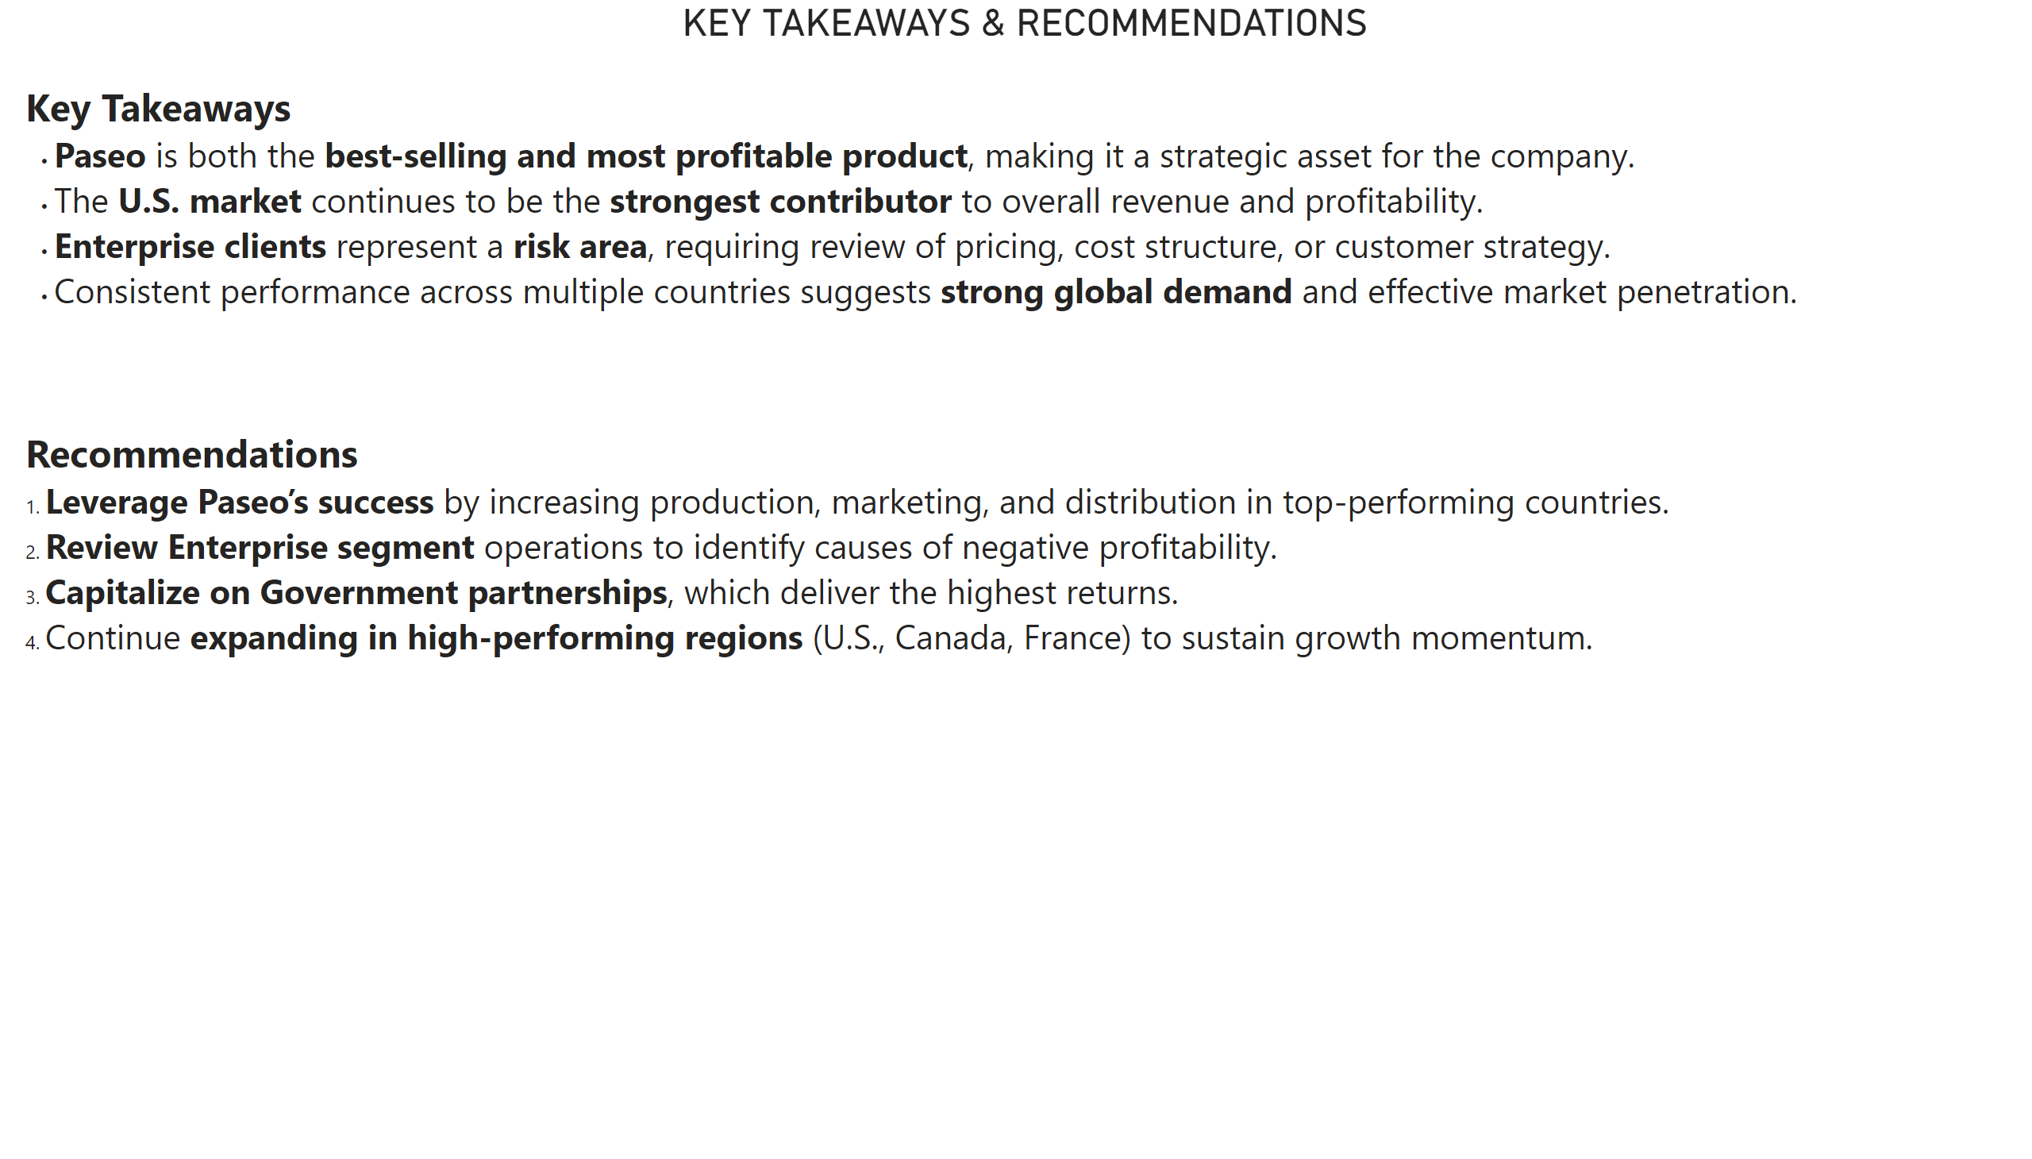
Recommendations
Notes:
KEY TAKEAWAYS & RECOMMENDATIONS
No alt text provided

Slide 4
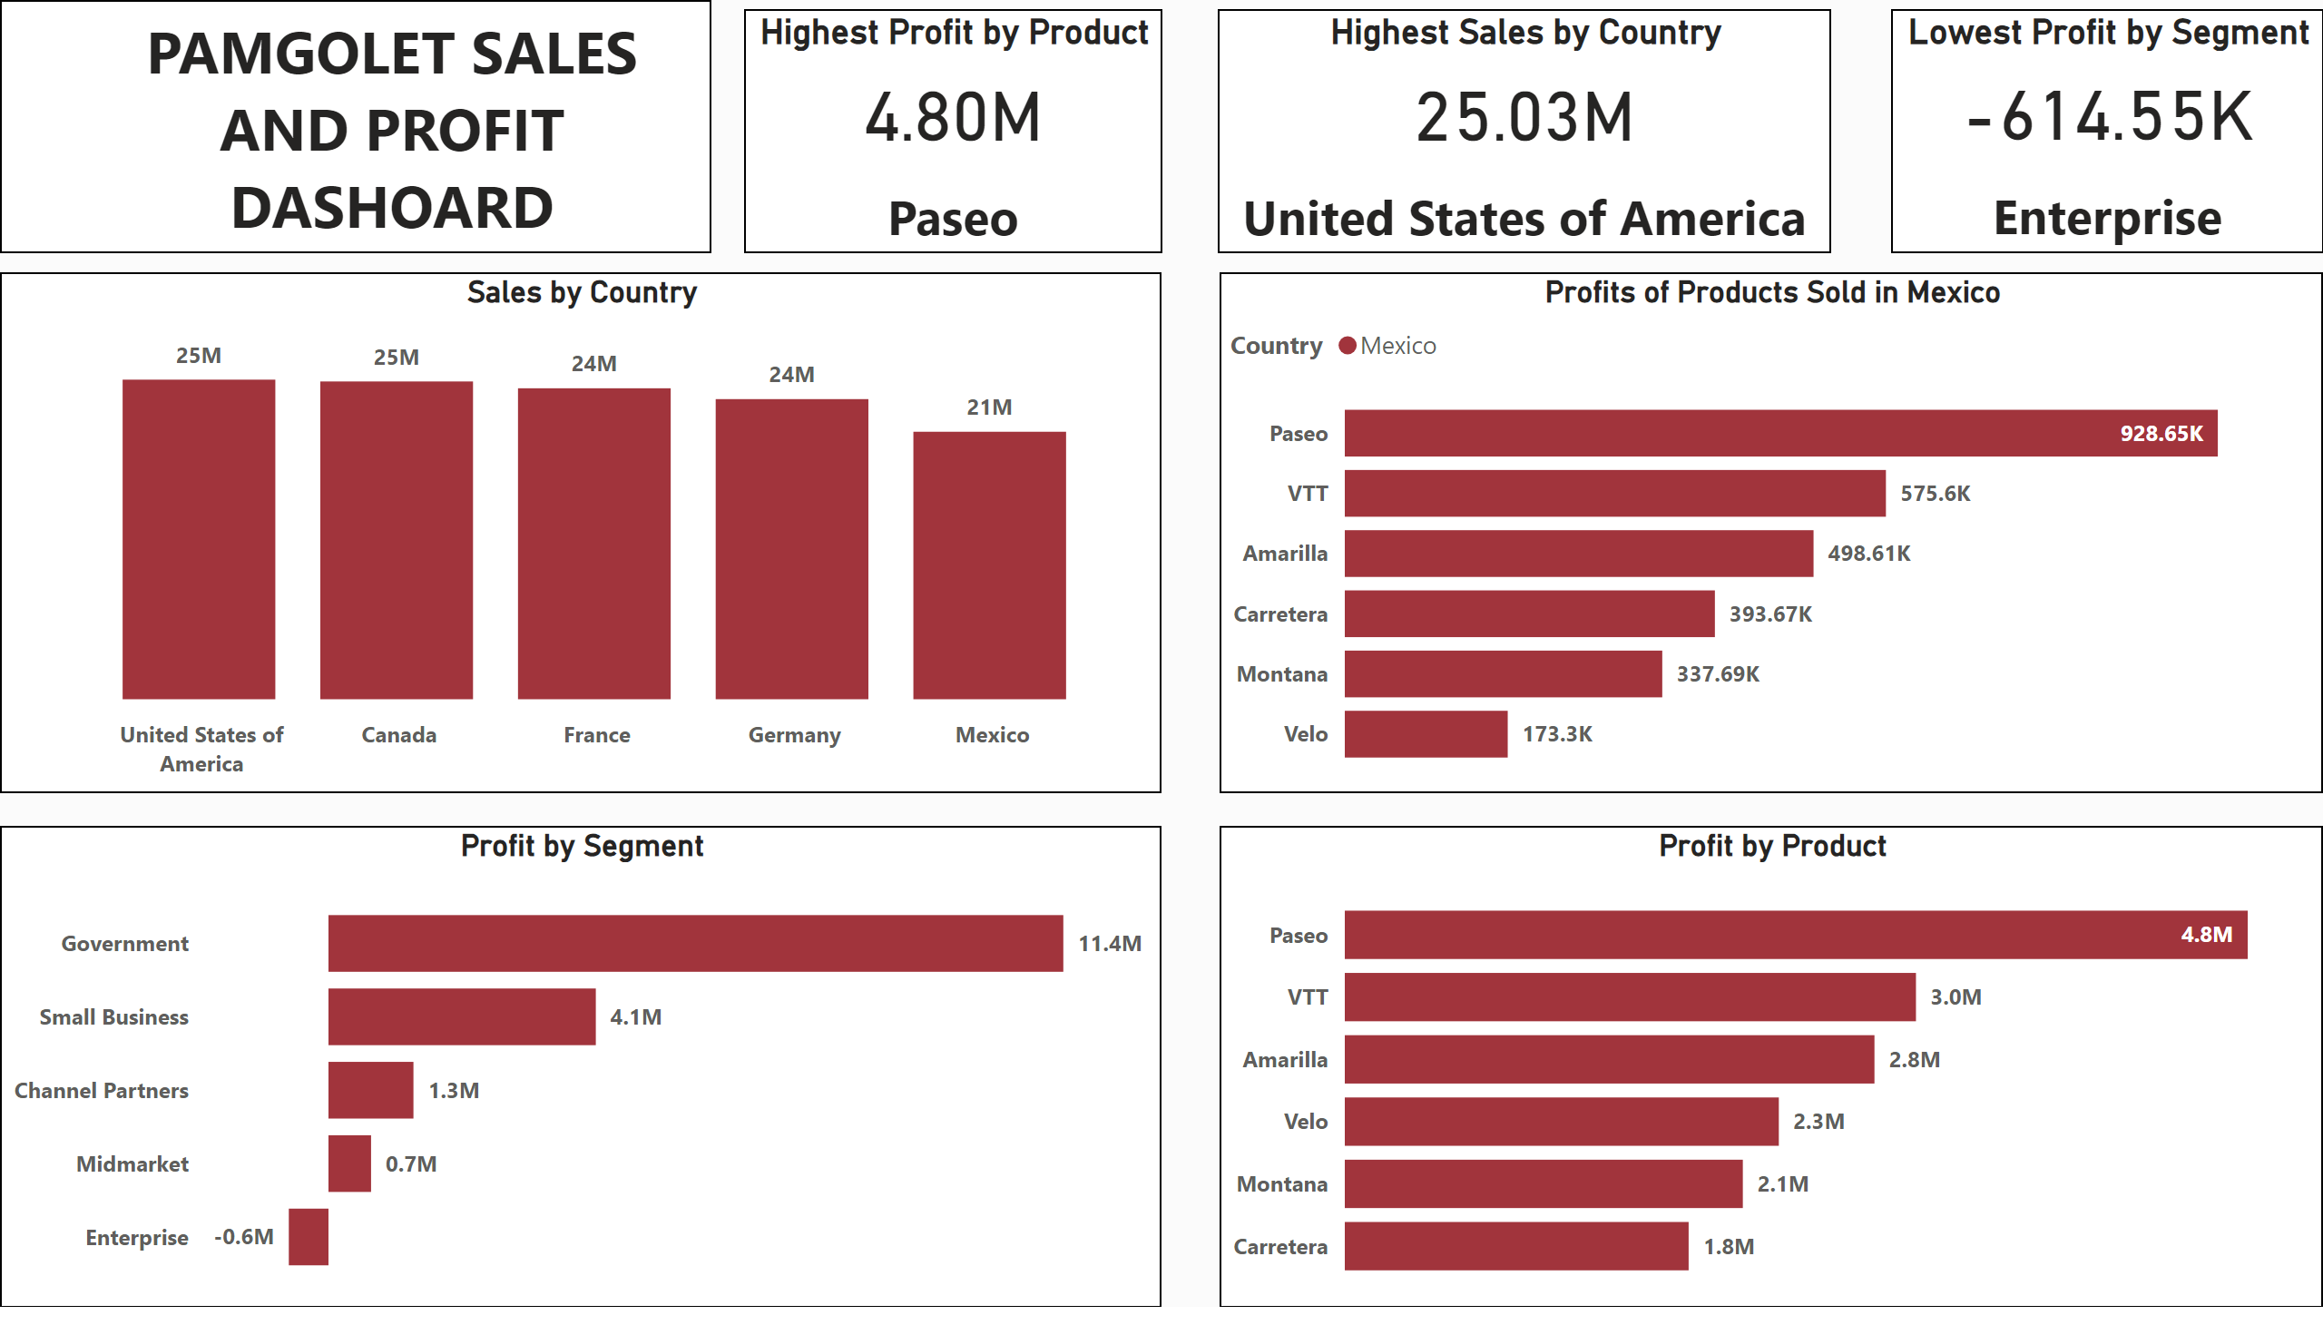
Profits
Notes:
Profit by Product
No alt text provided
Sales by Country
No alt text provided
Profit by Segment
No alt text provided
Profits of Products Sold in Mexico
No alt text provided
Highest Profit by Product
No alt text provided
Highest Sales by Country
No alt text provided
Lowest Profit by Segment
No alt text provided
textbox
No alt text provided

Slide 5
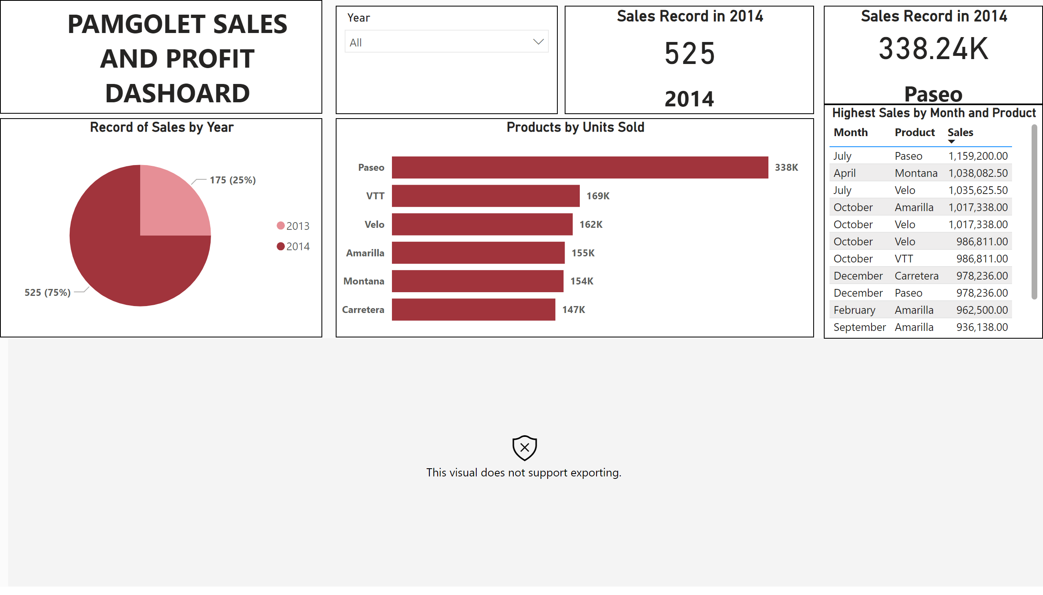
Sales
Notes:
Products by Units Sold
No alt text provided
Record of Sales by Year
No alt text provided
Sales by Country
No alt text provided
Sales Record in 2014
No alt text provided
Sales Record in 2014
No alt text provided
Highest Sales by Month and Product
No alt text provided
slicer
No alt text provided
textbox
No alt text provided

